Slide 1

Project 4 – Predicting Employee Attrition
Ayesha Maryam, Athul Madhusudhanan, Mujahid Iqbal, Edward Vaughan, Daniel Daniel

Slide 2
Background

Slide 3
Data Source
IBM HR Analytics Employee Attrition & Performance
From IBM
Sourced from Kaggle: https://www.kaggle.com/datasets/pavansubhasht/ibm-hr-analytics-attrition-dataset/discussion/233758
Wide variety of metrics to analyse
1470 records

Slide 4
Data Importing

Slide 5

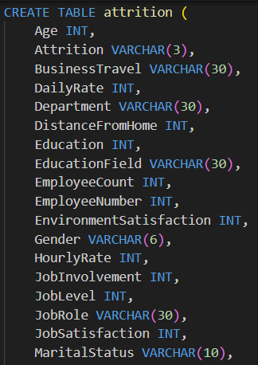
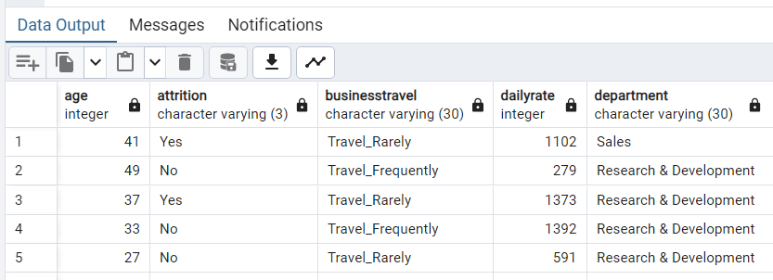
PostgreSQL

Slide 6

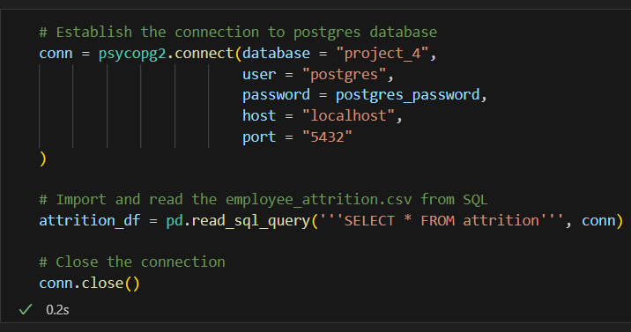
Psycopg2
Database connection established.
SQL query executed, and DataFrame created.
Connection closed at the end.

Slide 7
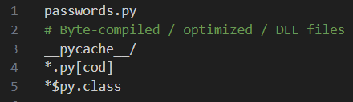
gitignore
File containing postgres password (passwords.py) added to gitignore.

Slide 8
Data Preprocessing

Slide 9
Input Data
Column | Description
Age, Gender, Marital Status, Over 18, Work Life Balance, | Personal Details | Features
Daily Rate, Hourly Rate, Monthly Income, Monthly Rate | Salary
Business Travel, Distance from Home | Commute
Education, Education Field | Education
Department, Job Level, Job Role | Job Details
Environment Satisfaction, Job Satisfaction, Relationship Satisfaction | Job Satisfaction
Num Companies Worked, Total Working Years, Years At Company, Years In Current Role, Years With Curr Manager | Work History
Job Involvement, Percent Salary Hike, Performance Rating, Years Since Last Promotion | Job Performance
Employee Number, Employee Count | Identification Details
Overtime, Standard Hours | Hours
Training Times Last Year | Other
Stock Option Level | Perks
Attrition | Attrition | Target

Slide 10
Dropping columns
EmployeeCount
1
EmplyeeNumber
Identification Number
Over18
All participants were over 18
Standard hours
All staff worked the same standard hours of 80.

Slide 11
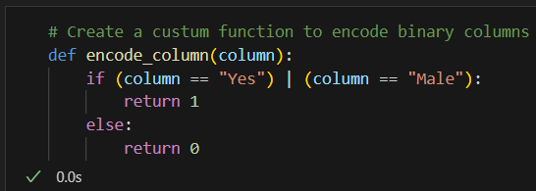
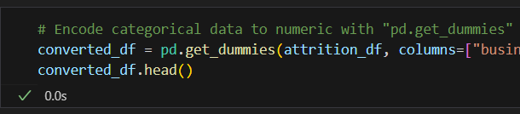
Encoding
Attrition
Yes or No
Gender
Male or Female
OverTime
1 or 0 (for Yes or No)
BusinessTravel
Department
EducationField
JobRole
MaritalStatus

Slide 12
Logistic regression model

Slide 13
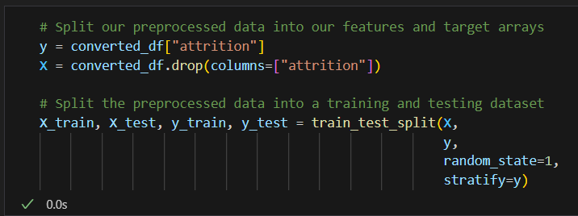

Slide 14
Evaluation

Slide 15
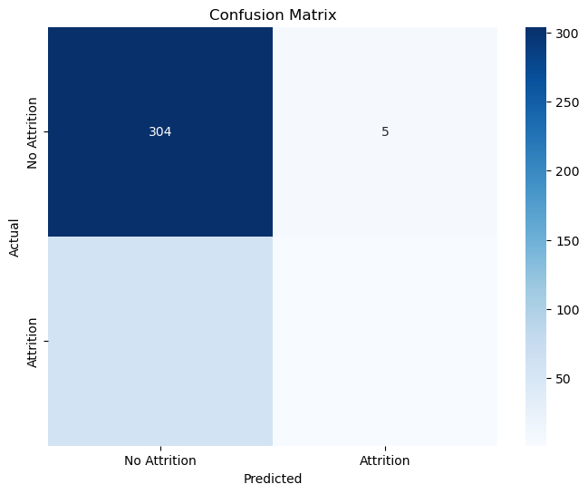
Evaluating the lr model
accuracy | 0.83
 | precision | recall | f1-score
Attrition | 0.84 | 0.98 | 0.91
No Attrition | 0.17 | 0.02 | 0.03

Slide 16
Optimisation

Slide 17
Optimisation methods
Model coefficients
Permutations
Correlation analysis
Further pre-processing
RFE (Recursive Feature Elimination)

Slide 18
Model coefficients

Slide 19
Model coefficients evaluation

Slide 20
permutations

Slide 21
Permutations evaluation

Slide 22
Correlation analysis

Slide 23
Correlation analysis evaluation

Slide 24
Further pre-processing

Slide 25
Further pre-processing evaluation

Slide 26
RFE (Recursive Feature Elimination)

Slide 27
RFE evaluation

Slide 28
Summary
From the confusion matrix, the classifier does very well on no attrition, correctly labelling all the samples. It does less well on attrition, getting all but one wrong.
From the classification report, the precision (the ability of a classifier not to label a negative sample as positive) is good for both attrition and no attrition. The recall (the ability of a classifier to find all the positive samples) is good for attrition but bad for no attrition.

